Slide 1

Car Sales Analysis & Price Prediction
Harshadeep Choudhary Kommareddi
Mohammed Abdul Rehman
Jasminder Ahluwalia
Lynn Ricky Jude

Slide 2
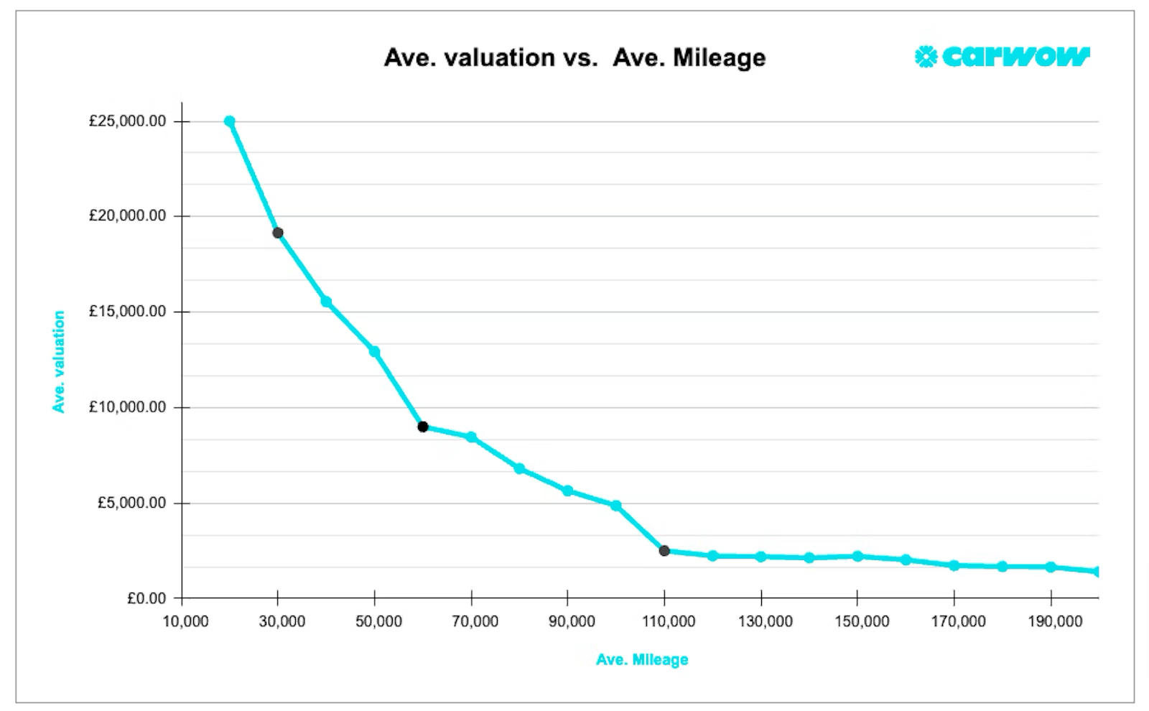
Background
Car valuation is essential for buyers, sellers, and organizations in the ever-changing automotive market.
The following factors such as brand reputation, mileage, fuel type, vehicle age and change in market trends affect the car prices.
With advancements in big data and machine learning, the industry can leverage data-driven methods to refine car price predictions.

Slide 3
Project Overview
The project utilizes machine learning techniques to predict car prices.
Key steps include:
Data preprocessing to clean and prepare data.
Feature engineering to extract meaningful insights.
Model evaluation to ensure accurate and reliable predictions.
The system analyzes attributes such as:
Brand and model
Year of manufacture
Mileage
Fuel type and specifications
The model identifies patterns in historical data to provide accurate price predictions, aiding decision-making for buyers, sellers, and professionals.

Slide 4
Objectives
Model Development:
Predict car prices based on multiple attributes.
• Market Analysis:
Analyze key factors influencing car pricing.
• Stakeholder Insights:
Generate actionable insights for buyers, sellers, dealerships, financial institutions.
Aid in data-driven decision-making.
Scalable System:
Build adaptable system for diverse datasets and markets.
Ensure capability to evolve with new data and trend.

Slide 5
Applications
For Buyers and Sellers:
Offers reliable insights into the fair market value of vehicles, enabling more informed purchasing or selling decisions.
Enhances transparency in the used car market by providing data-backed valuations.
For Dealerships:
Streamlines inventory pricing strategies, ensuring competitive pricing that reflects real-time market conditions.
Provides a deeper understanding of which car models are in demand and the ideal pricing for profitability.
For Financial Institutions:
Helps banks evaluate vehicle values accurately for loan approvals and collateral assessments.
Supports insurance companies in determining fair premium calculations based on vehicle valuations.
For Market Analysts:
Enables detailed analysis of trends affecting car prices, including economic shifts, technological advancements, and consumer preferences.
Facilitates accurate forecasting of market movements, aiding businesses in strategic planning.

Slide 6
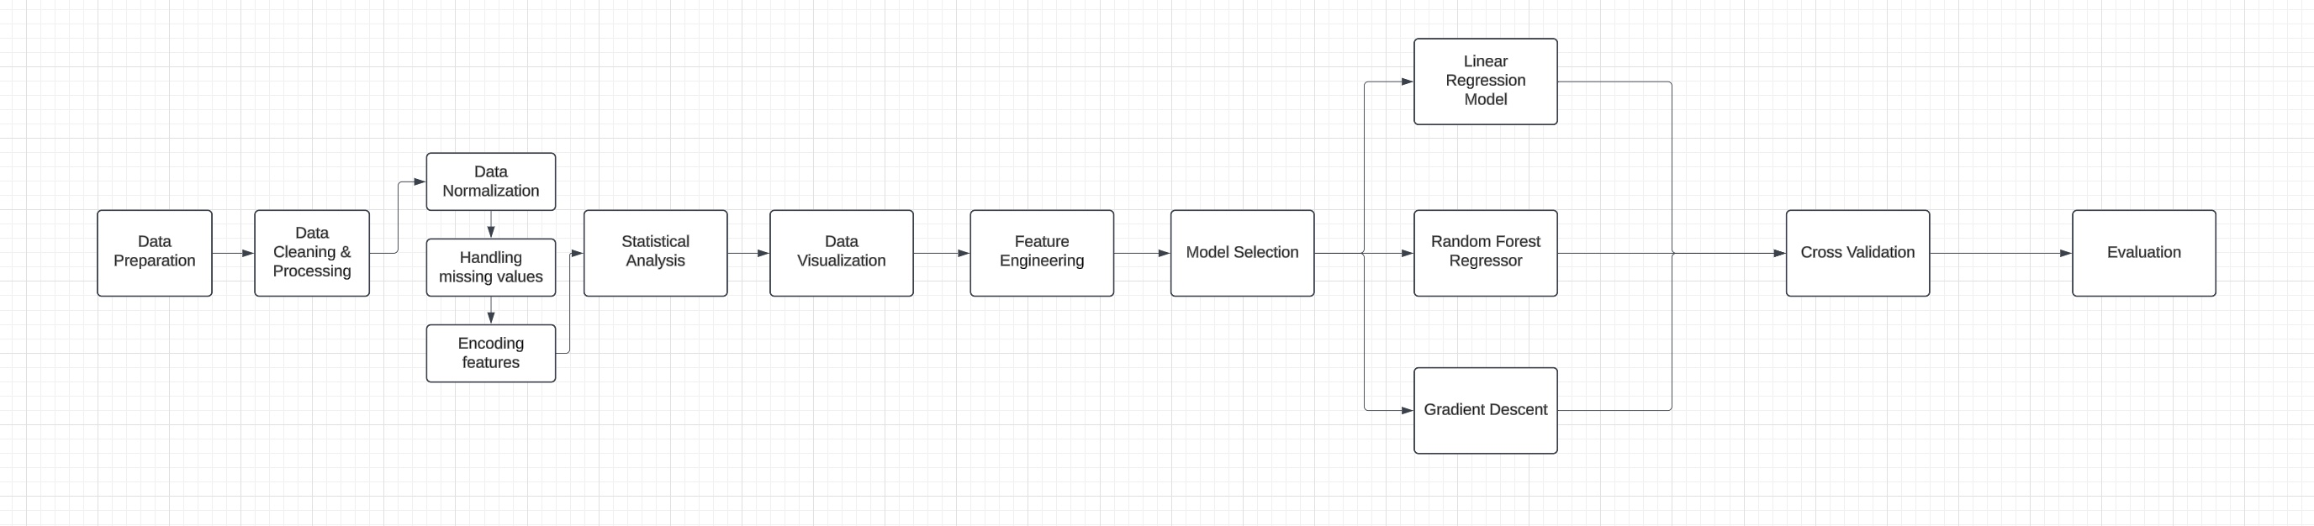
Workflow

Slide 7
Dataset
The dataset selected for this project contains detailed information about 2000 used vehicles from the Indian automotive market, all scraped from cardekho.com. The dataset contains cars from 30 different companies and 1000 different models, it is sourced from Kaggle and includes essential attributes for analyzing resale prices. Its size and structure are suitable for the linear regression model as it provides a variety of numerical and categorical variables.
Size and Structure:
Total Entries: 2000 rows
Attributes: 20 columns including both numerical and categorical data.
Categorical Variables: Make and Model, Fuel Type, Transmission, and Drivetrain, Ownership and Seller Type, Location and Color:
Numerical Variables: Price, Year and Kilometers and Dimensions and Specifications.

Slide 8
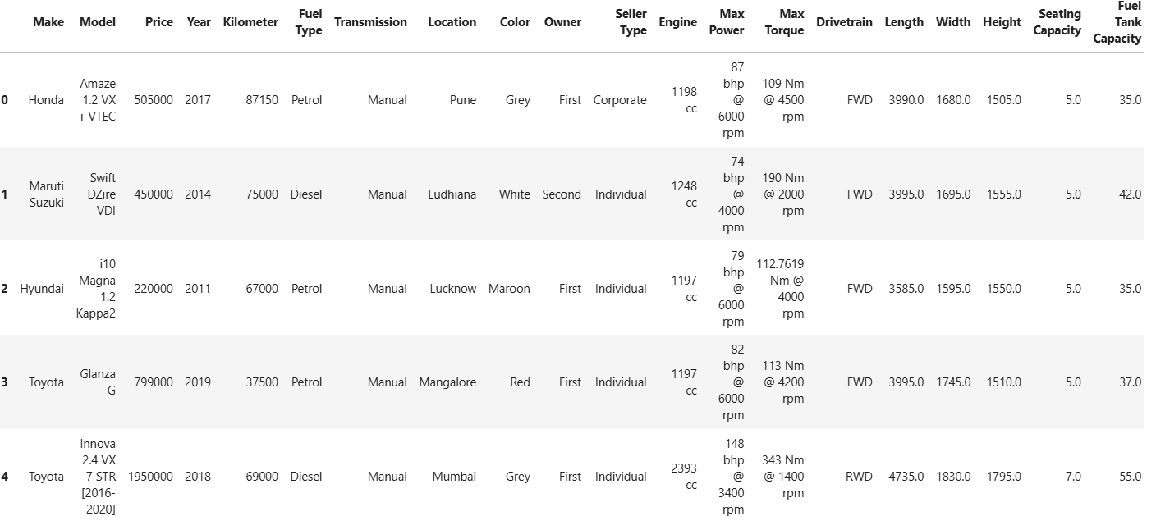

Slide 9
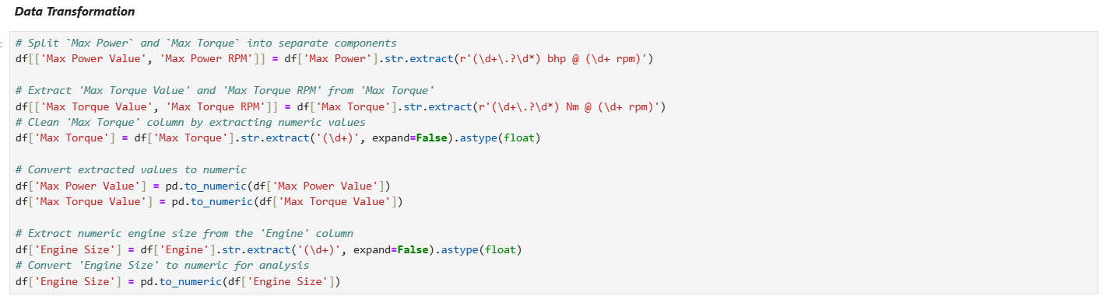
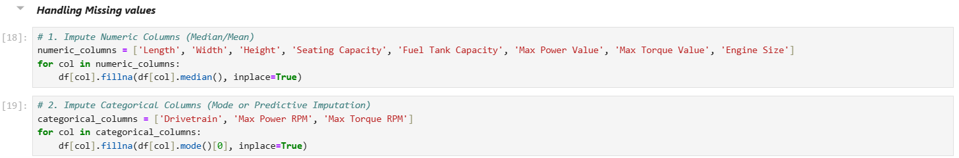
Preprocessing

Slide 10
Statistical Analysis
Statistical analysis plays a critical role in understanding the dataset, identifying trends, and detecting anomalies, ultimately improving model performance.
Key Analysis Steps:
Central Tendency Measures:
Mean, Median, Mode – Analyze average values and common patterns.
Spread Measures:
Standard Deviation & Variance – Measure variability.
Range – Assess data spread and detect outliers.
Distribution Analysis:
Skewness – Identify symmetry and tail heaviness.
Normality Check – Test if data follows a normal distribution.

Slide 11
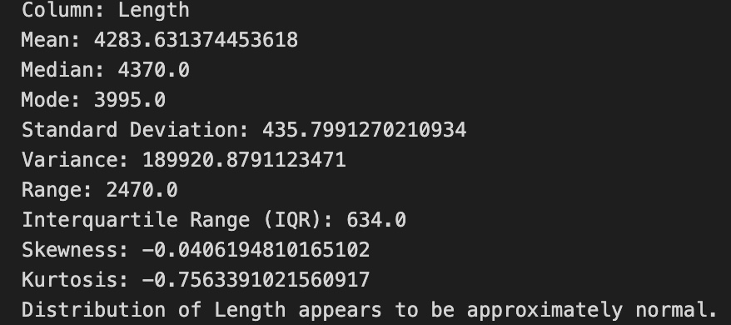
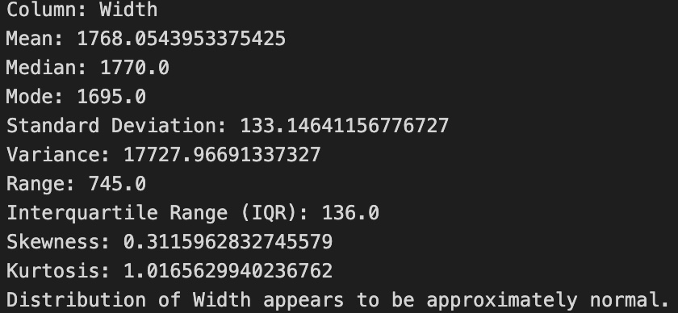
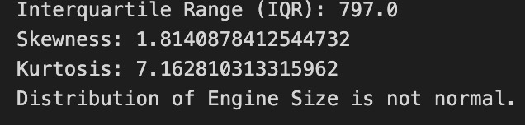
Results
Length, Width, Height, Fuel Tank Capacity:
1) Approximately normal distributions.
2) Slight variations in skewness and kurtosis.
3) Moderate variability with broad value spread.
Skewness analysis:
1) Provides insights into feature distributions
2) Indicates potential presence of outliers

Slide 12
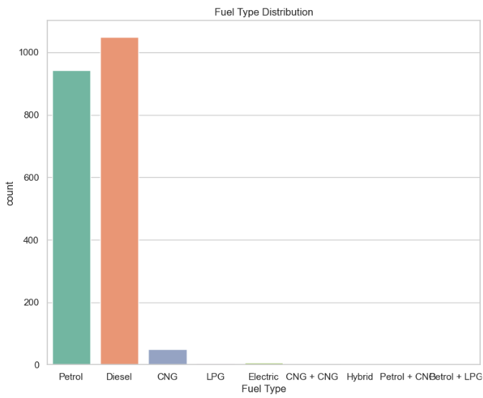
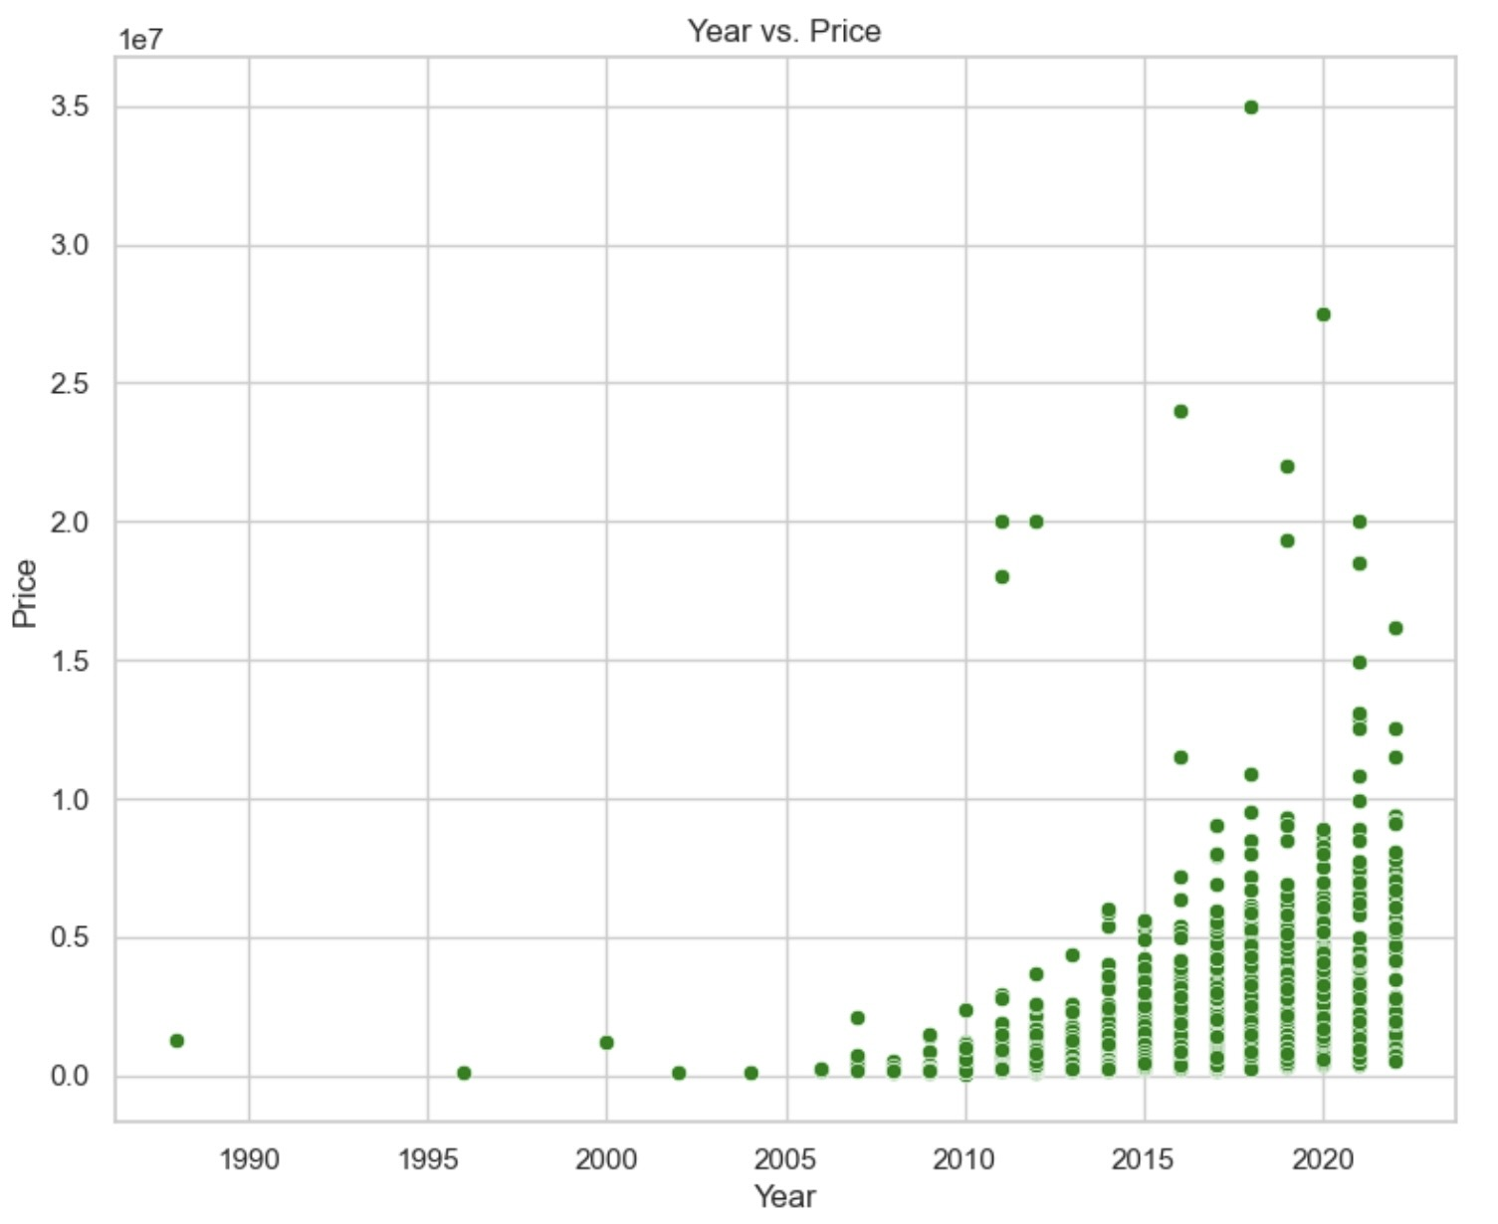
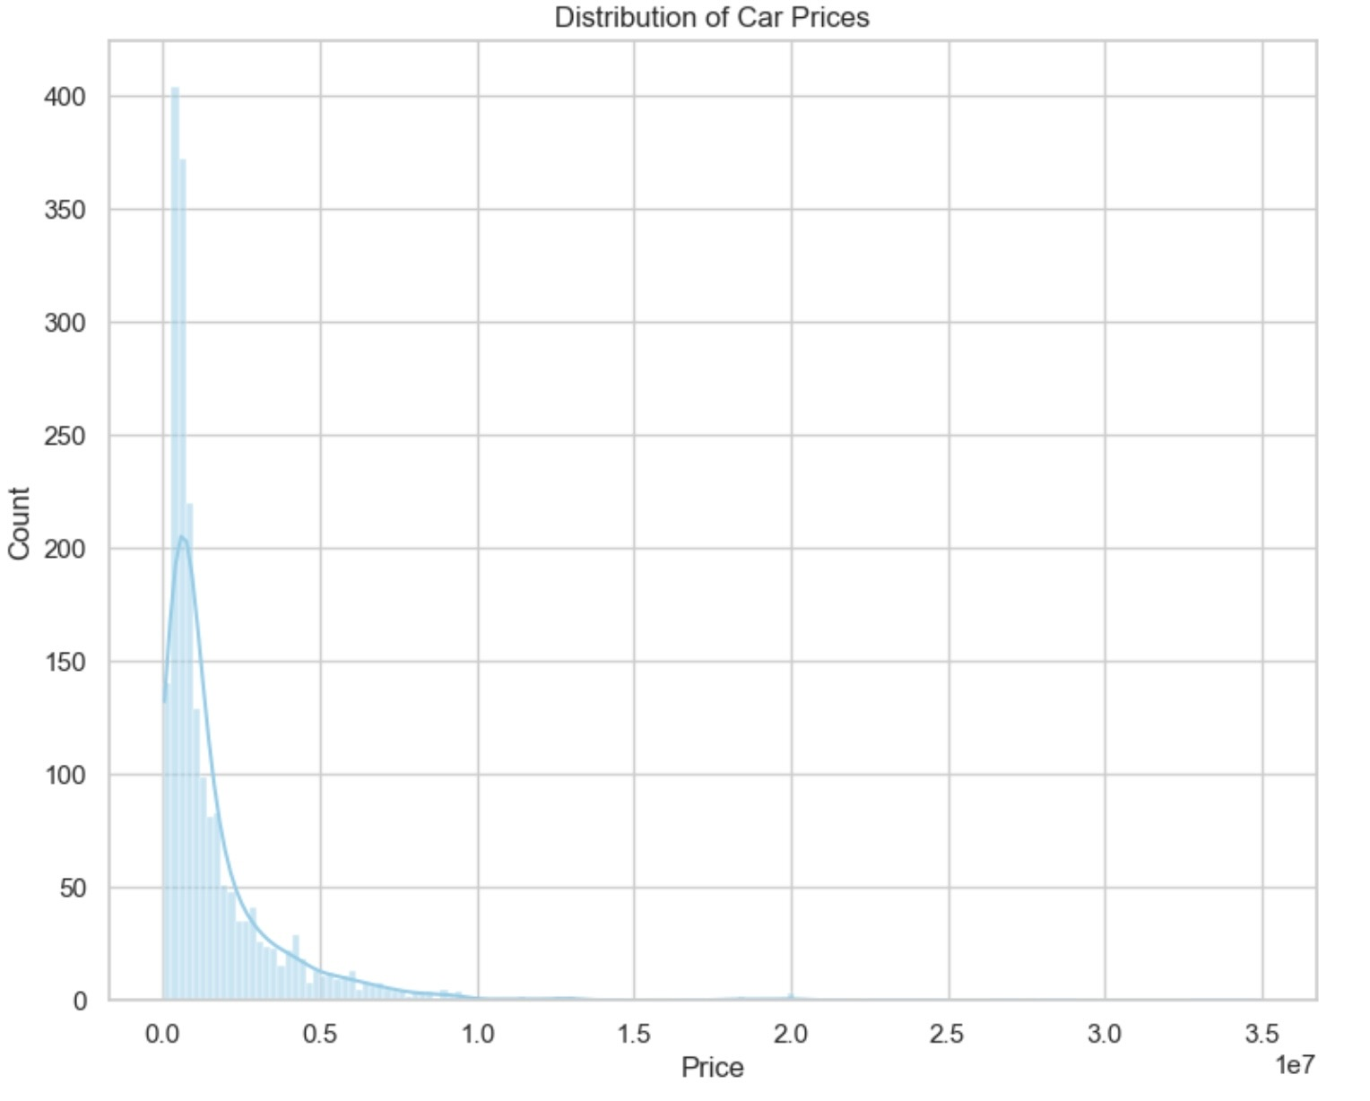
Data Visualization

Slide 13
Results
Reveals critical insights into automotive market structure and dynamics.
Market Composition:
Smaller luxury segment indicated by skewed price distribution.
Diesel and petrol vehicles dominate fuel type category.
Provides comprehensive understanding of market structure and pricing dynamics.
Highlights the fundamental importance of data visualization in market analysis.

Slide 14
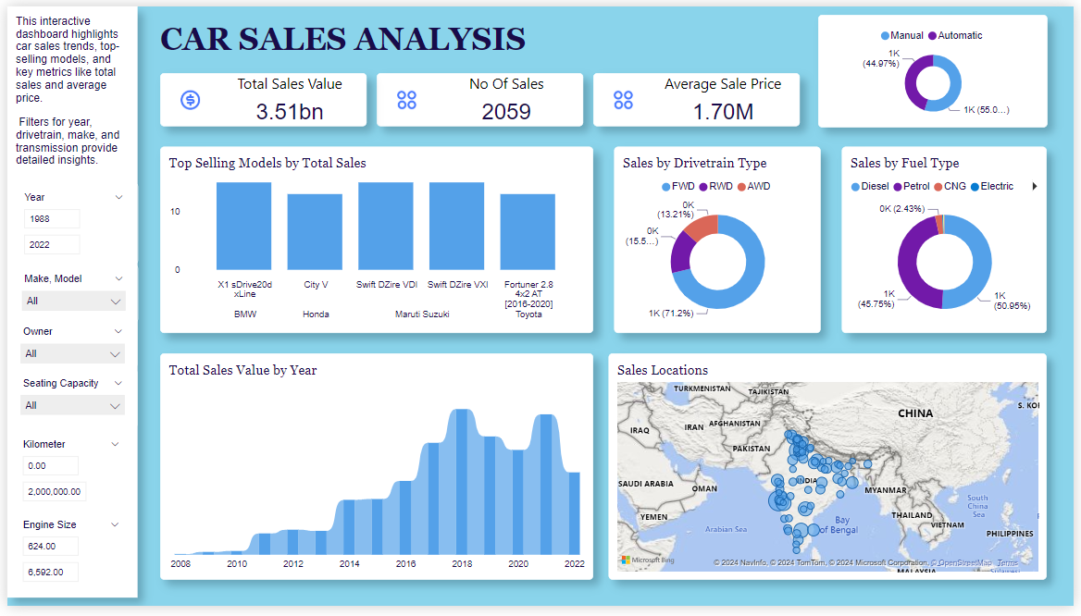

Slide 15
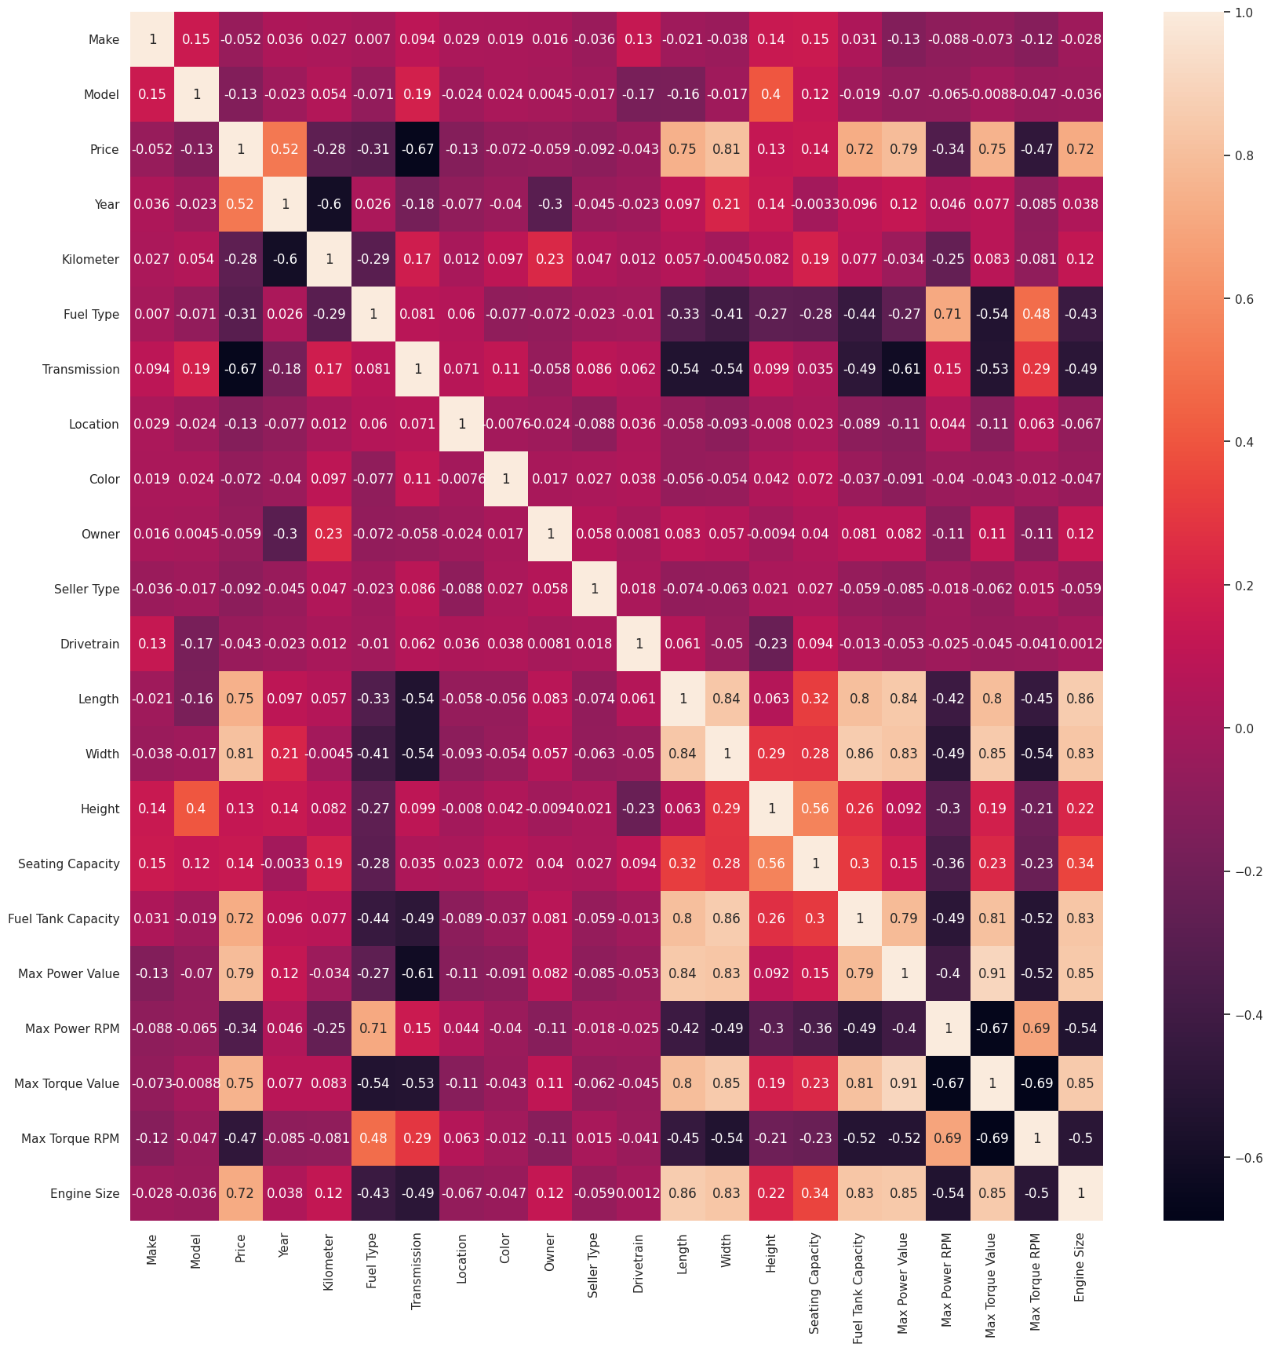
Feature Selection

Slide 16
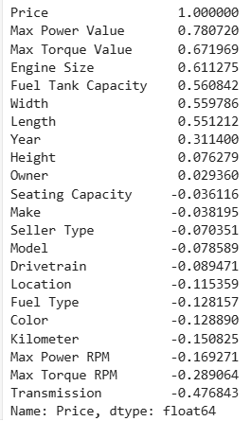
Feature Selection

Slide 17
Models
1. Linear Regressor:
A simple regression model that predicts a target variable by fitting a straight line based on input features.
2. Random Forest Regressor:
An ensemble model that combines predictions from multiple decision trees to improve accuracy and reduce overfitting.
3. Gradient Boosting Regressor:
A sequential ensemble model that builds trees iteratively, optimizing for errors in previous iterations to enhance predictive performance.

Slide 18
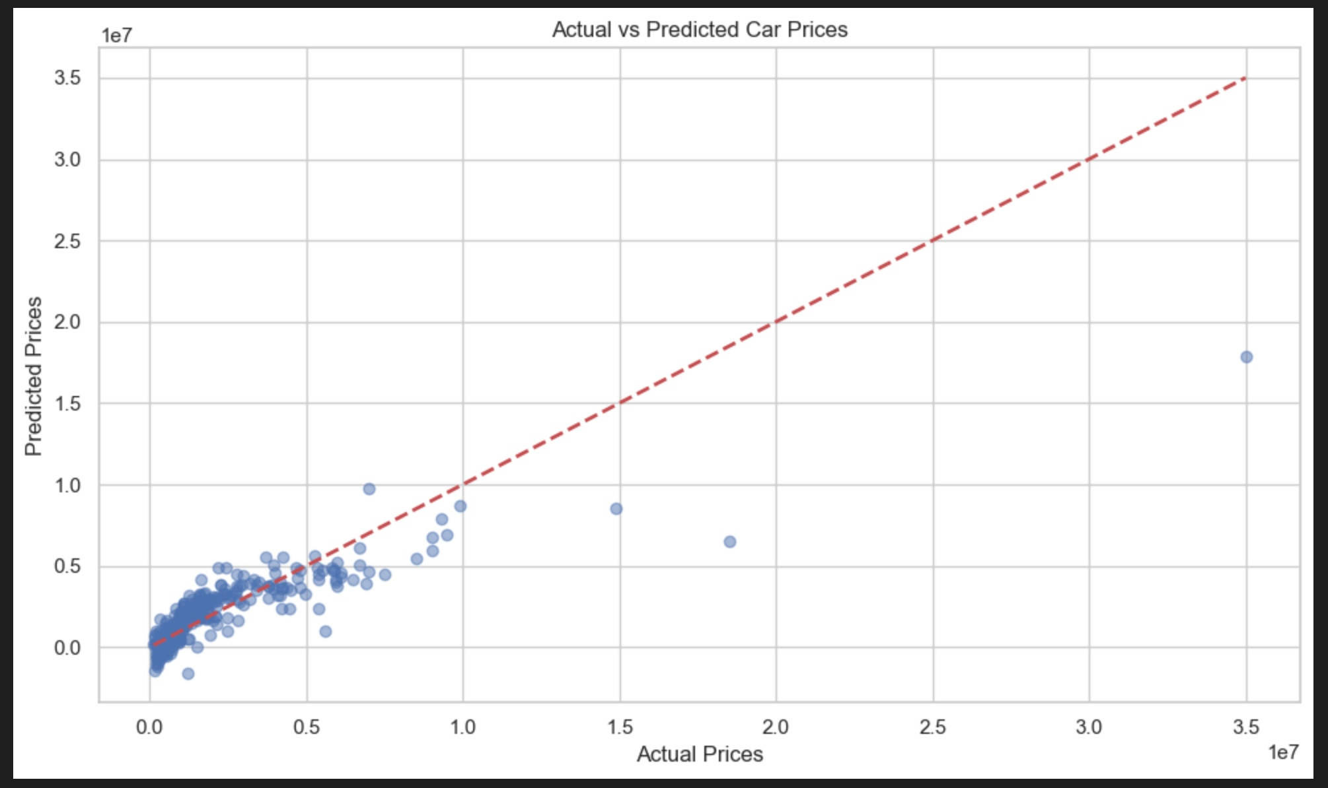
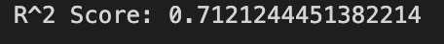
Initial Results
The initial Linear Regression model had a moderate R² score, indicating that it explained approximately 71.21% of the variance in the target variable (car prices).
Overall, the Linear Regression model demonstrated a decent performance but had significant room for improvement.

Slide 19
Cross Validation
Cross-validation
1) Statistical technique to evaluate ML model performance and reliability.
2) Involves splitting dataset into multiple subsets or "folds”.
3) Model trained on some folds and tested on remaining fold.
4) Process repeated several times.
5) Assesses model's ability to generalize to unseen data.
Error Analysis
1) Helped identify high margins
2) Guided switch to Random Forest for better predictions.

Slide 20
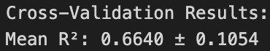
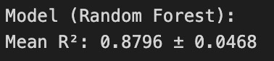
Cross-Validation Results
Random Forest Regressor:
1) Explains more variance
2) Generalizes better across different folds
3) Shows stronger predictive accuracy and stability
4) Explains 88% of the variance in car prices
Random Forest demonstrates superior performance in predicting car prices
More reliable for practical applications in the automotive market.

Slide 21
Feature Engineering
Feature Engineering: 1) Process of transforming raw data into meaningful features.
2) Represents underlying patterns in the dataset better.
3) Makes it easier for ML algorithms to learn and predict accurately.

Slide 22
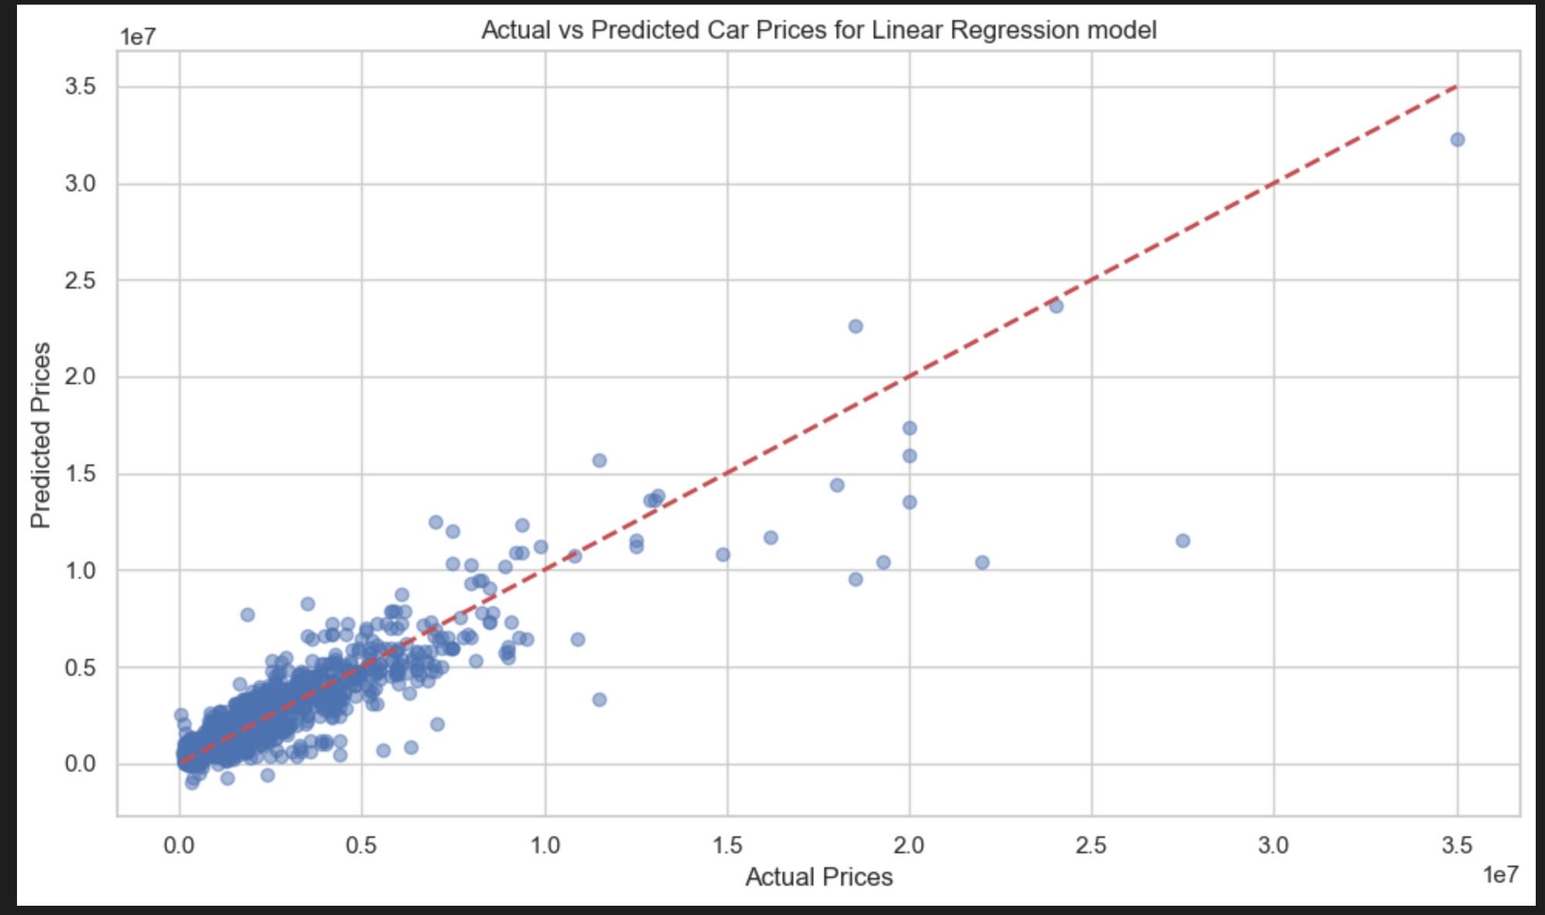
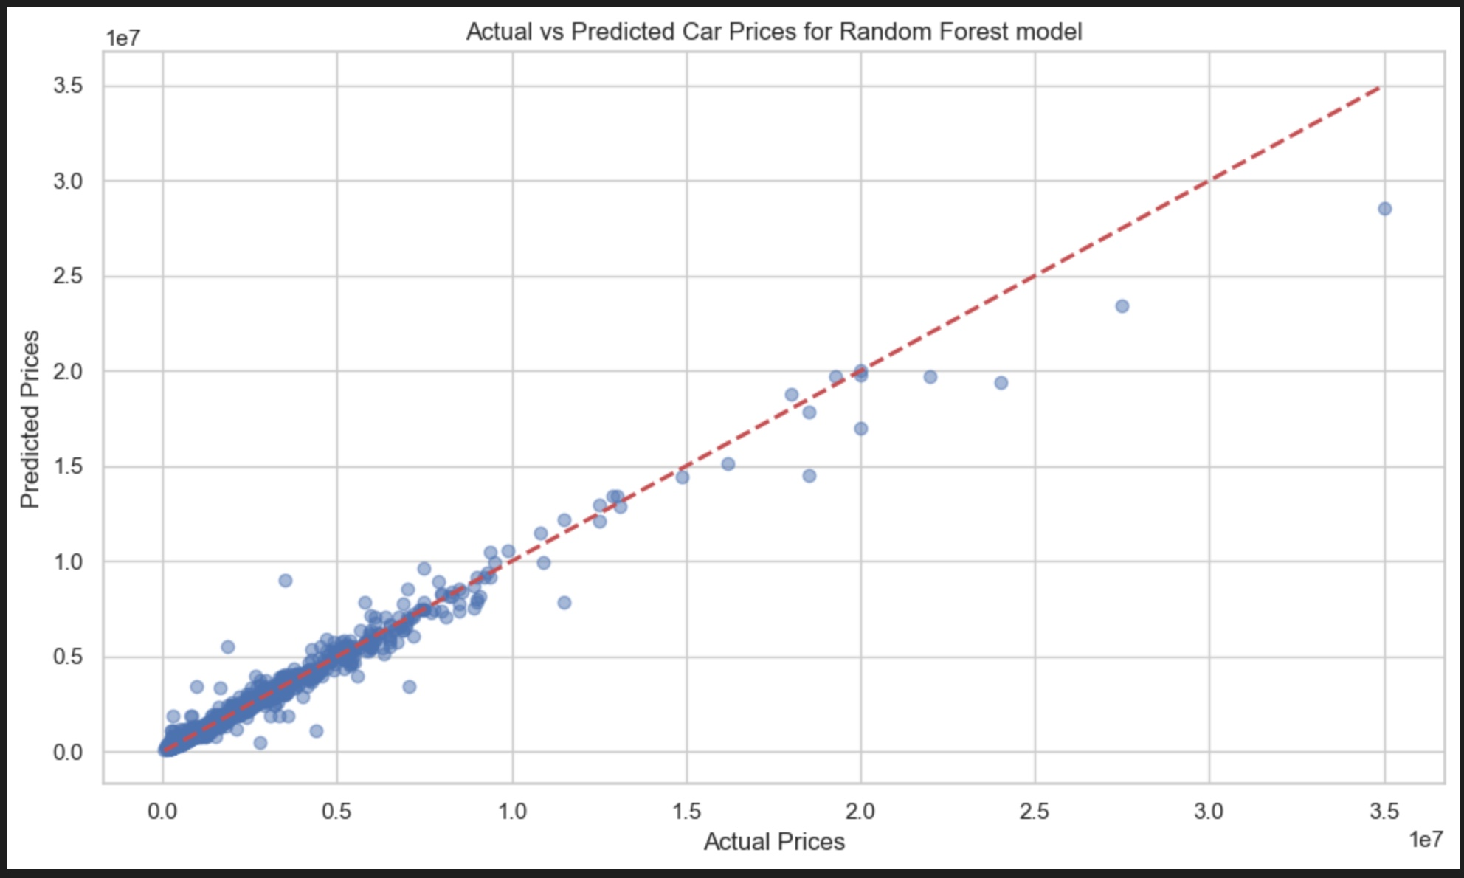
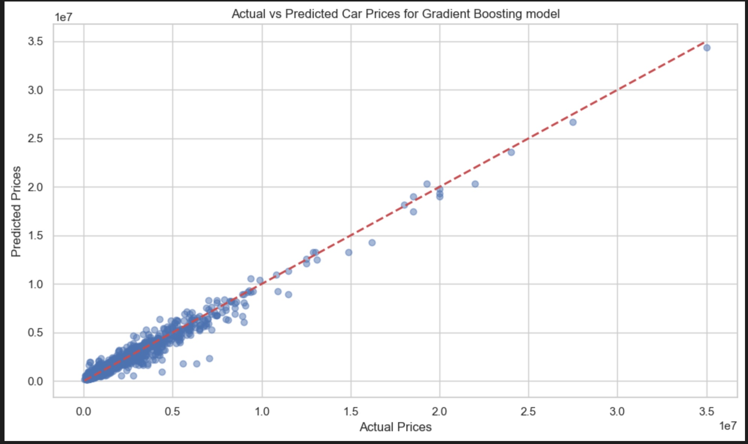
Results
The Random Forest model showed the best performance with a high R² of 97.33%, indicating a strong predictive capability.
Gradient Boosting also performed well with an R² of 96.67%, making it a competitive model.
Linear Regression, although performing well after the inclusion of polynomial features, had the lowest R² of 83.68%, which still reflects an improvement over the baseline linear model.
Overall, the process of refining the feature set, experimenting with different models, and applying feature engineering has proven to be crucial in developing a robust, high-performing car price prediction model.

Slide 23
Conclusion
The project demonstrated the significant impact of feature engineering and model refinement in car price prediction, with the Random Forest model achieving the highest accuracy, an R² of 97.33%.
The Gradient Boosting model also performed strongly with an R² of 96.67%, while the Linear Regression model with polynomial features improved to an R² of 83.68%, though it still lagged behind the ensemble methods.
These results highlight the importance of iterative model improvement, which can be applied across various industries like marketing, healthcare, and finance for accurate predictions and informed decision-making.

Slide 24
THANK YOU

